Slide 1
Xtelligent Healthcare Media Capabilities

Slide 2
Xtelligent Healthcare Media is a premium digital publisher
100% Focus on healthcare, specifically on the issues that matter most
Our digital footprint is deep and wide
Organic search traffic drives visitors, registrations and page views
Page views and unique visitors have grown >100% YOY
Our database of registered users has grown over 30% YOY
The difference is audience engagement:
Healthcare executives and IT professionals stay on story pages for an average of 3-5 minutes
The quality and responsiveness of our audience to advertising messaging is quantifiable and consistent
Partner content is valued as an extension of the editorial content

Slide 3
We create engaging, targeted content
We deliver deep content about important segments of the healthcare ecosystem to healthcare executives and it professionals
Our audience self-selects content by topic across the Xtelligent Healthcare Media platform.
Engagement spans multiple sites and events per subscriber. These change as their priorities shift — driven by job roles, project responsibilities and a general need-to-know.
Subscribers consume quality content through targeted media:
Websites
Newsletters
White Papers
ebooks
webcasts
Events
And other media related to their interests.

Slide 4

Xtelligent Healthcare Media Platform
Our digital media properties reach >300,000 unique visitors that view nearly a million pages of high quality healthcare information each month

Slide 5
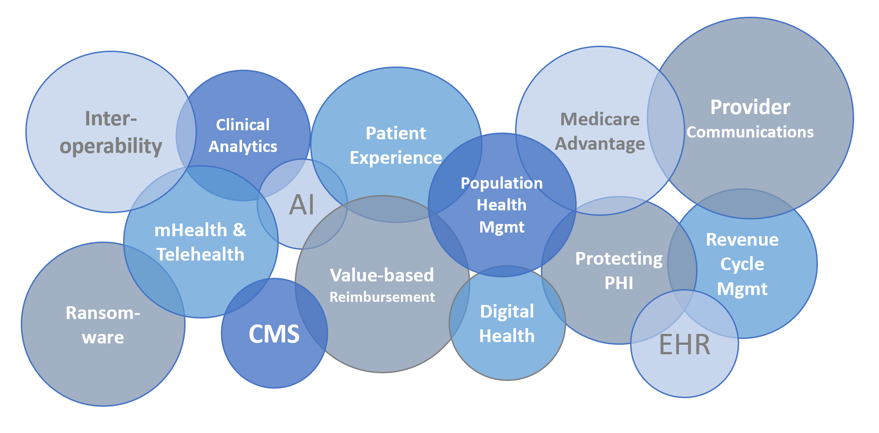
We know what’s on the minds of 300,000+ healthcare executives and IT professionals
Our audience accesses TOPICAL content across the Xtelligent platform

Slide 6

We view the healthcare ecosystem through three lenses
OUR multi-faceted data creates targeted buyer seller connections
① Healthcare Executives
② IT Professionals
③ Product Vendors & Service Providers

Slide 7

B2B Marketers face more challenges than ever before
Only 8% of marketing executives feel that their marketing campaigns “consistently achieve expected results.”
What about the other 92%?
Source: DiscoverOrg

Slide 8
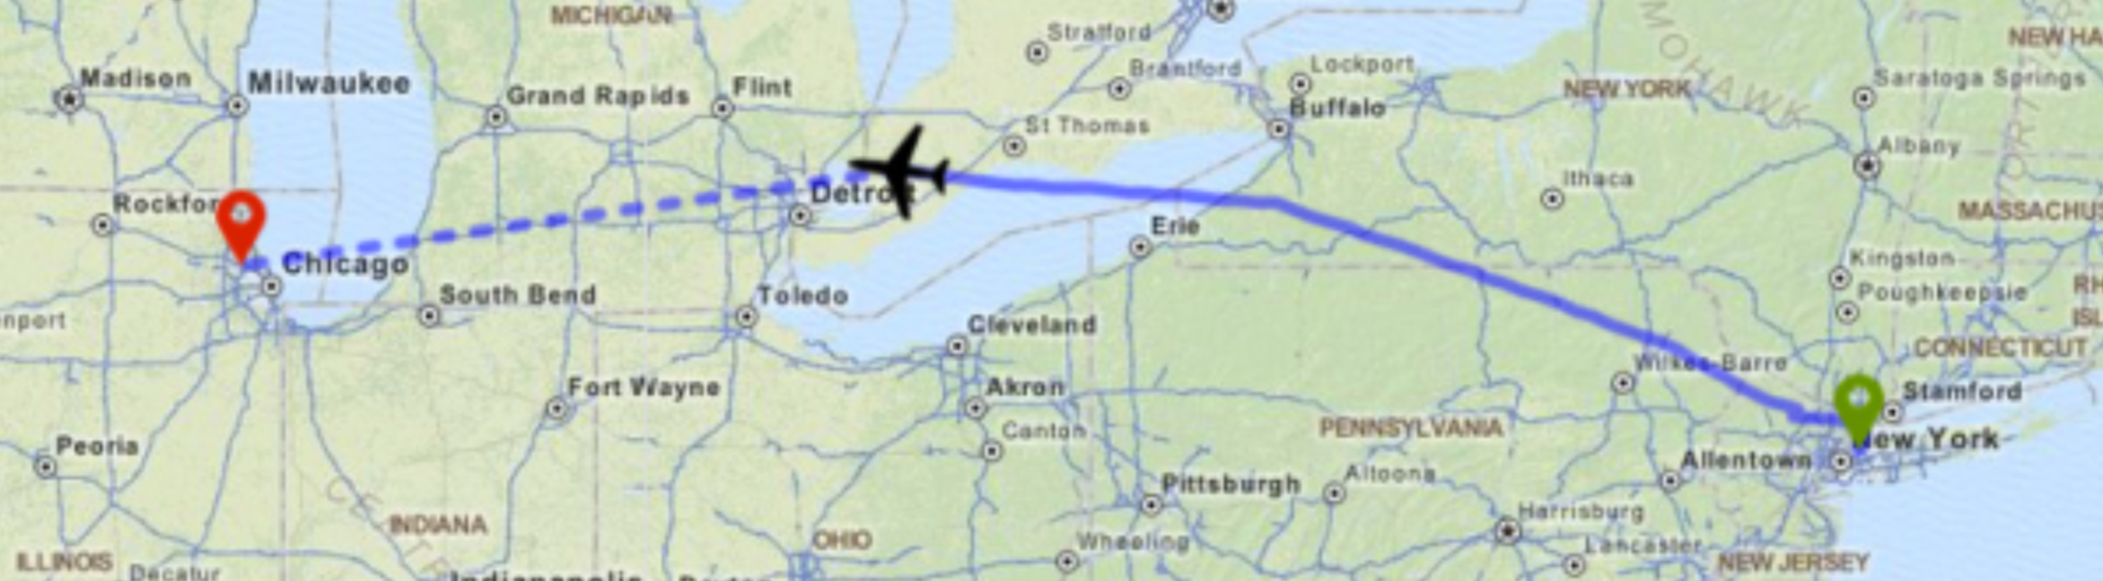
Buyers have a head start
Marketers must proactively develop dialogue with buyers long before they begin to shop for a solution
67%
of the Buyer’s Journey is done digitally.
(Sirius Decisions)
8

Slide 9
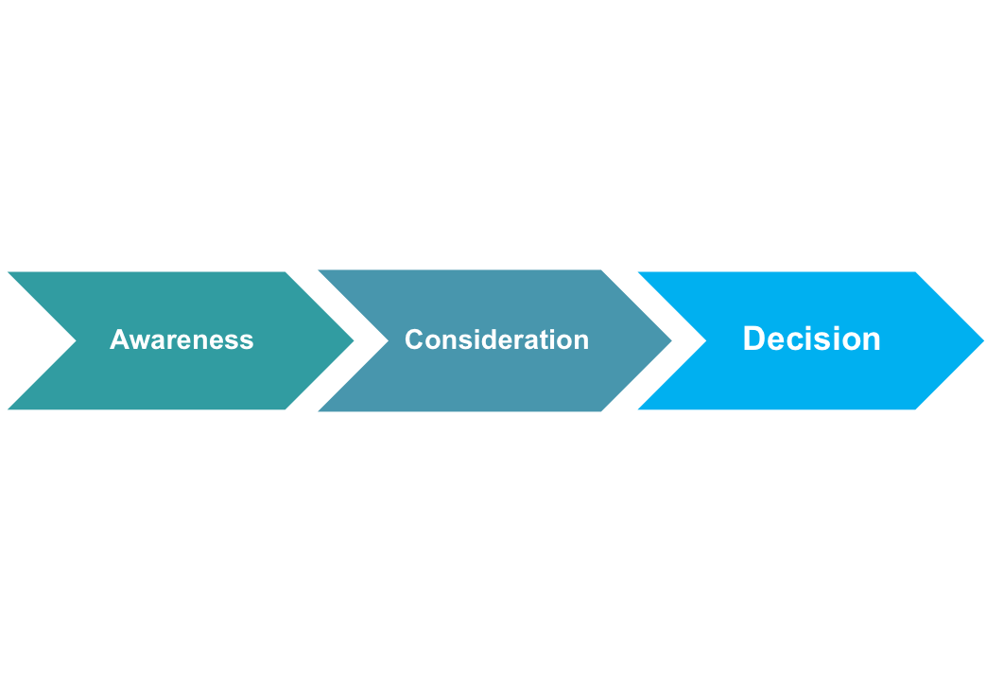
The Buyer’s Journey
Vendors need to create awareness and influence up-front or risk missing a place on the short list
Self-guided research
Direct outreach to vendors
Brand messaging
Thought leadership
Third-party reports
Category education
Peer recommendations
Vendor-written content
Case studies, testimonials
Third-party data (comparisons)
Demos
Analyst research
Content Consumption

Slide 10
ROI begins with brand
“Your brand is whatever your customers say it is….” -- groundswell
With so much research conducted by buyers prior to raising their hand, brand education is critically important.
Successful marketers combine branding with lead-gen to drive informed response.
Leads are more qualified & drive higher ROI.
10

Slide 11
Lead generation and nurturing
With longer buying cycles and more stakeholders involved, it’s not enough to generate a lead, you must nurture it.
4-10x
Lead nurturing emails get 4-10x the response rate compared to standalone emails. (DemandGen Report)
response
Companies that excel at lead nurturing generate
50% more sales leads @ 33% lower CPL
(Forrester Research)
We deliver leads and provide content for nurturing, so you’re keeping pipelines filled and sales teams happy.

Slide 12
Content is critical to marketing success
95%
40%
60%
of B2B buyers rely on content to make buying decisions
DemandGen: 95% of B2B buyers consider content as trustworthy when evaluating a company and its offerings
of marketing execs struggle to produce the quantity of content needed
of B2B content marketers can’t keep up with the need for high quality content
Content Marketing Institute/ MarketingProfs: 60% of B2B content marketers say their biggest challenge is producing engaging content
Canam Research 2016 Data-Backed Trends Report: 40% of Marketing Executives report that “creating enough content on a regular basis” is a major challenge

Slide 13




Reach organizations across the entire healthcare ecosystem
Top Organization Types
Accountable Care Organization
Ancillary Clinical Service Provider
Federal/State/Municipal Health Agency
Hospital/Medical Center/ Multi-Hospital System/IDN
Outpatient Center
Payer/Insurance Company/Managed Care Organization
Pharmaceutical/Biotechnology/ Biomedical Company
Physician Practice/ Physician Group
Skilled Nursing Facility

Slide 14
Reach >300,000 buyers and influencers
Job Functions
82%
Director or above
Analyst
Network Administration
CEO/President/Administrator
Nurse/Nursing Executive
Clinical Management
Physician
CMIO
Non-IT Staff
25%
C-Suite Executives
Consultant/Systems Integrator
Privacy Officer
CSO
Sales/Marketing
Finance/Accounting
Senior IT Management
(CIO/CTO/CSO/VP/Director)
IT Management (Manager IS/IT)
23%
Involved in Medical/Quality/ Care Management
IT Staff
Senior Non-IT Management (CMO/CFO/VP/Dir)
Legal/Regulatory/Compliance

Slide 15

Editorial excellence and expertise
6 things that make Xtelligent’s editorial team different – and better
Exclusive focus on healthcare; actionable intelligence and problem-solving insight
Topic- and issue-driven approach to in-depth content (not quick-hit news)
Industry role as thought leaders: trusted source for data, trends and insights
Solid, practical understanding of the pressures facing providers and payers
Unique ability to put issues into context from multiple vantage points
Strong connection with our audience and network of subject matter experts

Slide 16
“Our clients’ success is our success.”
Sean Brooks, CEO
Xtelligent Healthcare Media

Slide 17
“
What Clients Are Saying About Our Events
“This was Eagle Telemedicine’s first year as a sponsor for the Telehealth Summit, and I can say this was one of the best all-around industry events in which we’ve been involved – well exceeding our experiences at the larger, more recognizable shows. The conference was very well planned, the sessions were timely and informative, and the organizers did everything possible to drive traffic to exhibitors. We secured a significant number of qualified leads as a result. In fact, we’ve already agreed to sponsor the Value-Based Summit in Boston this fall.” VP of Marketing and Business Development – Eagle Telemedicine
“I found the Summit 2019 to be a very good meeting that was intimate with quality attendees. There was an excellent cross section of individuals that included leadership, decision makers and those wanted to acquire knowledge. The speakers were all very knowledgeable and from nationally known organizations involved in Telehealth. The venue was excellent and fit the meeting perfectly. – Business Development Executive - URAC

Slide 18
“
What Clients Are Saying About Our Events
“The 2019 Telehealth Summit was by far the best conference/summit we’ve attended this year. It is very important from a vendor perspective to be able to have meaningful conversations with the attendees. Many other events we have attended don’t offer adequate transition time or exhibitor access time for proper engagement. This event flowed nicely and allowed plenty of time for everyone to connect. I am already looking forward to the next summit. Thank you Xtelligent Healthcare Media for a great event.” Director of Accounts, Telehealth – Jackson and Coker
“This conference has exceeded my expectations and has been the most beneficial one I’ve attended around population health and technology challenges that my company is facing. The quality of presenters and topics were superb, and the intimate setting provided networking opportunities not available elsewhere.” – Manager of Clinical Informatics, Answer Health

Slide 19
“
What Clients Are Saying About Our Events
This was one of the best events I have ever attended. The speakers were well spoken. The slide decks were well done. I really liked attending this event, not just for the presentations but for being able to connect with other attendees.” – Business Analyst, Healthcare, Department of Veterans Affairs
“The topics discussed are timely and crucial to survival in today’s changing environment.” – Director of Analytics and Value-Based Care, University of Toledo Physicians
“All of the speakers provided an impressive level of insight into the topic at hand. I really appreciated the breadth of experience and the communal aspect of approaching our industry’s challenges” – Assistant VP, Finance/Managed Care, NYC Health & Hospitals
Informative and enlightening presentations, stimulating discussions on relevant and current topics – Definitely a worthwhile way to spend two days!” – Director, Informatics, Health Care Economics, Capital District Physicians’ Health Plan
“Excellent diversity of organizations represented though speakers. Action-oriented information is most appreciated.” – Quality Improvement Advisor, Uconn Health

Slide 20
“
“
…What our Clients Are Saying About Us
“Partnering with Xtelligent has really enabled us to reach a broader audience with our digital campaigns. Our webinar registrations have more than doubled since utilizing Xtelligent. We look forward to our ongoing relationship.” – Marketing Director - Alpha II
“I have worked with Xtelligent for years representing 3M Health Information Systems and have never been disappointed with either the service provided by sales or the analysis of our campaigns. Both sides of the business, sales and analytics, are prompt in getting back to me, providing the answers to any issue I may have. So for me, that’s critical with any vendor. But the best part has been the results. Our month-to-month performance for 3M HIS just keeps getting better, making this relationship a true partnership with one goal in mind…client success!” – Marketing Consultant – 3M
“
“Our lead generation program through Xtelligent has directly sourced 11 of our qualified opportunities in 6 months, and we have seen a 27% increase in ROI for our leads sourced through Xtelligent syndication programs. One of the best pieces of the programs for us has been the ability to syndicate multiple assets across multiple sites, allowing us to develop customer journey insights through those touchpoints.” – Director of Marketing - Verato
…

Slide 21
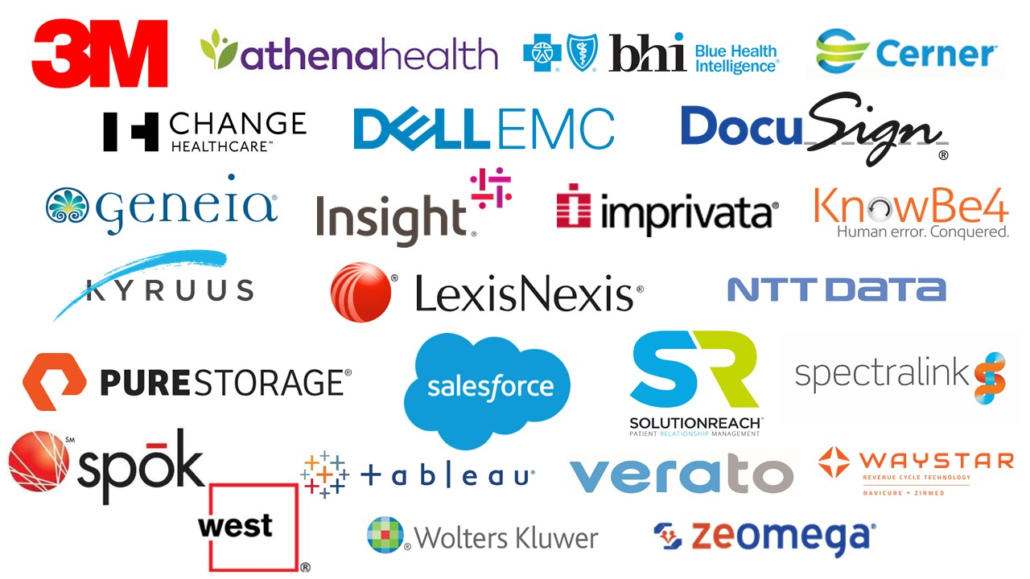
200+ Leading brands benefit from data-driven programs

Slide 22
Xtelligent Healthcare Media Product Overview

Slide 23






Solutions for every objective
Lead Generation
Deliver qualified leads that have engaged with relevant content to your sales team
Lead Generation
Thought
Leadership
Branding
Content Syndication
Webcasts
Thought Leadership
Feature your brand as a leader in the healthcare space by sharing your expertise through content
Custom White Papers, Reports & Surveys
Account-based Marketing
(ABM)
Brand Awareness
Promote your brand through display and email marketing
eBlasts
Newsletters
Events
Display Advertising

Slide 24
Account-Based Marketing (ABM)
ABM goes beyond lead-gen. it’s the foundation for 1:1 marketing
Marketers easily leverage Xtelligent Healthcare Media’s content-rich platform to host ABM outreach.
We use up-to-the-minute content consumption patterns and advanced marketing technology to deliver your message precisely to the organizations you’ve identified.
97%
97% of marketers report that ABM delivers higher ROI than other marketing activities

Slide 25

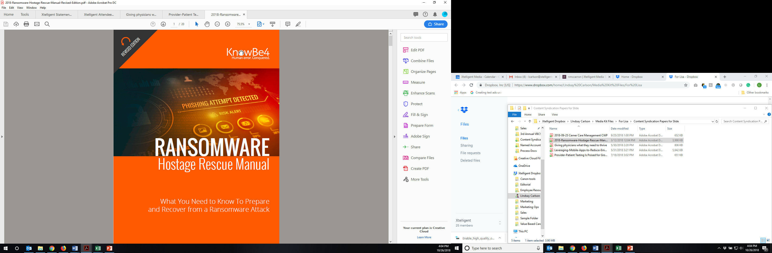

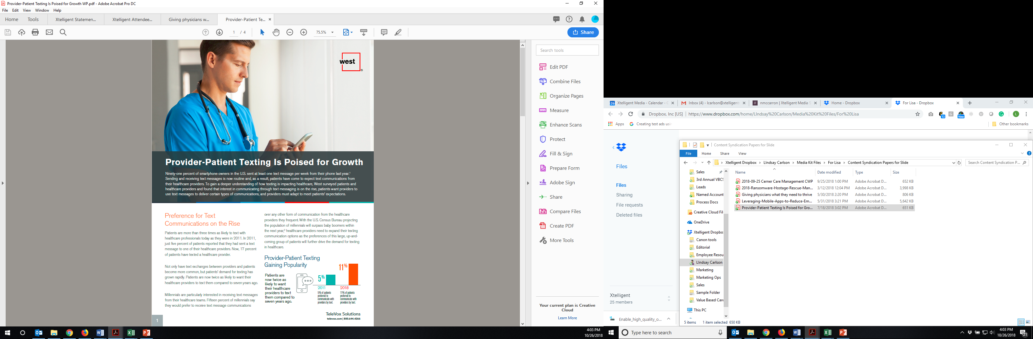

Content Syndication & Lead Nurturing
Use content to drive sales-ready leads
Content includes whitepapers, webcasts and case studies
All leads are screened to ensure they are from legitimate healthcare organizations.
We remove vendors, students, professors and consultants from lead delivery.
Lead Filters ensure you receive the exact leads you need:
Job Function
Organization Type
Organization Size
Account-Based
Nurture leads through the sales funnel:
Retarget leads with more detailed content
Deliver more qualified leads to your sales team
Comprehensive reporting based on lead activity and engagement

Slide 26

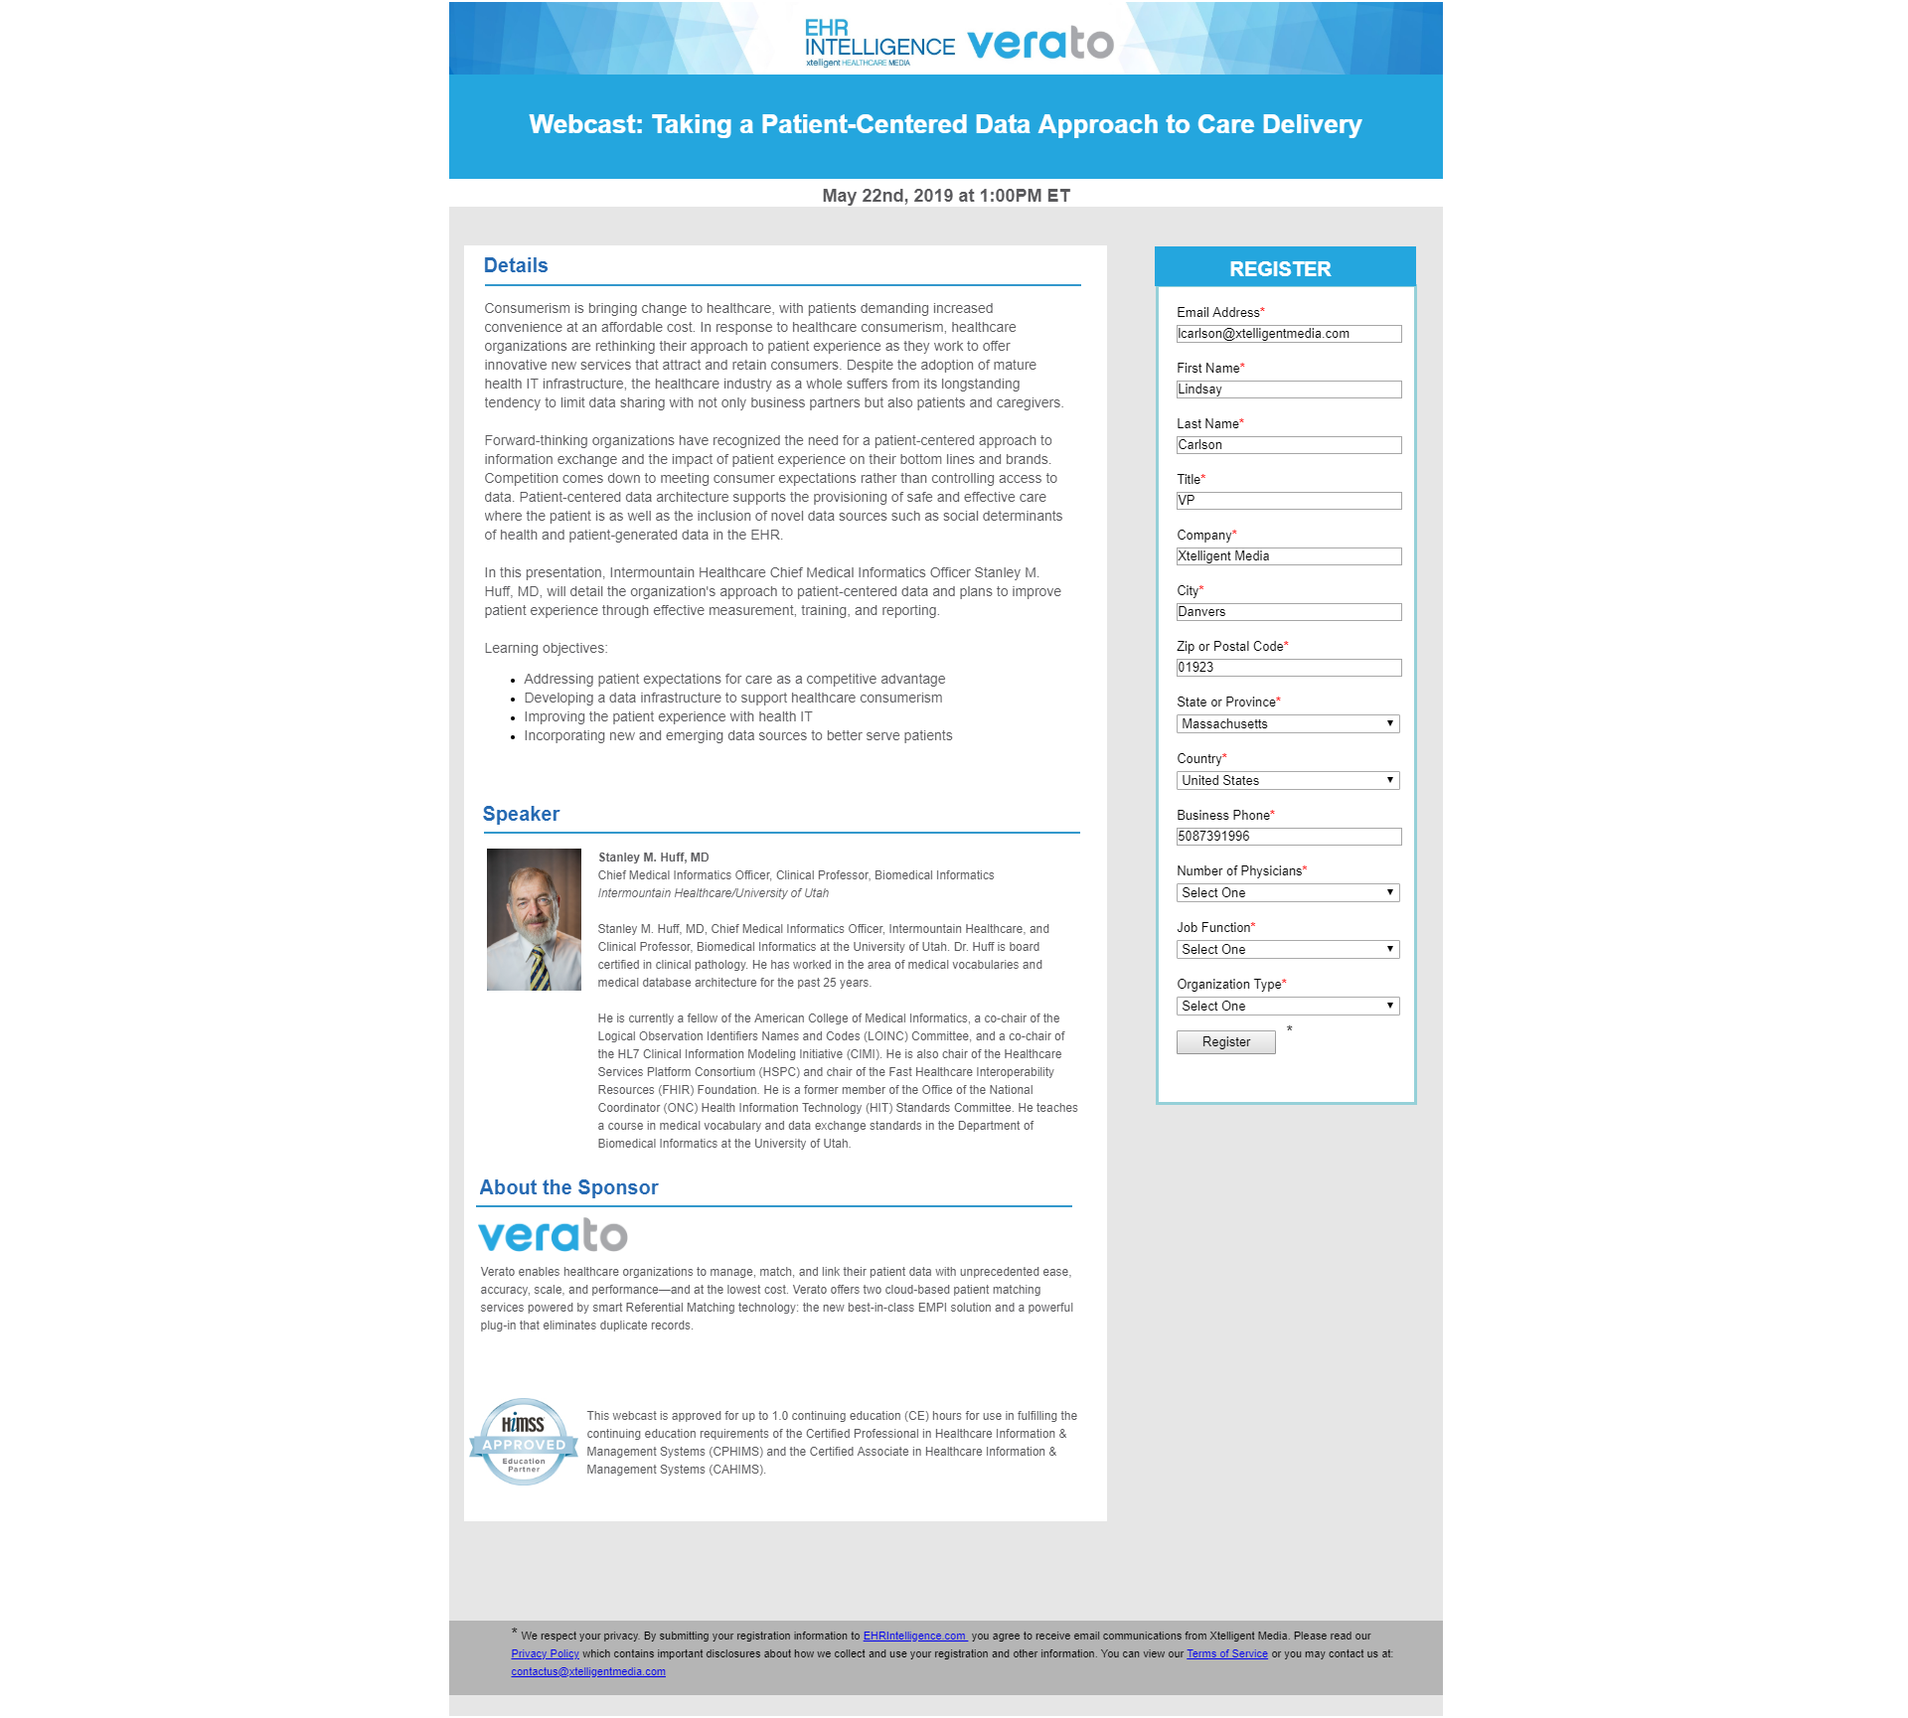
Webcasts
Share thought leadership and educational content with our highly engaged audience. Redistribute to increase reach and longevity.
Editorial Webcasts
Editor-driven webcast on your topic of choice
Our editors write content and recruit industry speaker(s)
Vendor Webcasts
Content is 100% controlled by vendor
Best Practices for Success:
Deliver education, high-level problem-solving and thought leadership
Ask a client to tell their story; audiences want to hear about first-hand experience. Case studies also perform well.
Speakers: VP or above, preferably thought leaders
Don’t present demos or sales pitches
Clearly identify attendee benefits
Webcasts include:
Minimum lead guarantee, but no cap
Network-wide promotion to drive registrations
On-demand access: 6 months post-event
Custom questions on the registration form

Slide 27

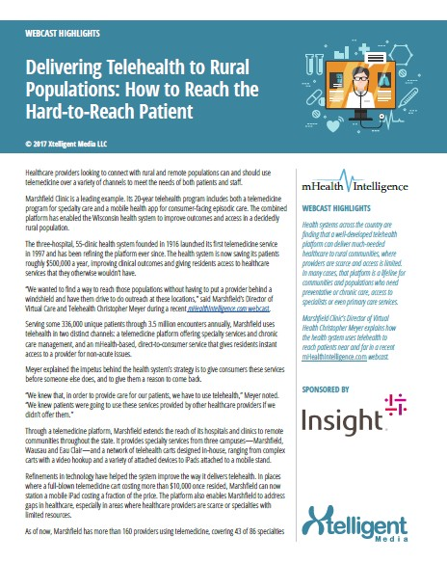


Custom Content
Custom content is an opportunity to use objective content that aligns with your brand messaging to reinforce your value proposition.
Options include:
Audience Surveys
Industry Event Coverage
Infographics
Podcasts
Webcast Executive Summary
White Papers
Additional custom solutions available

Slide 28
Xtelligent Insights (Primary Research)
Leverage our editors’ expertise and insights to reach our responsive audience through research projects. Identify industry trends, understand buyer dynamics and develop first-hand competitive knowledge.
Our easy four-step process produces and promotes insightful primary data.
Partner with our editorial team on proprietary research fielded to an audience that meets your criteria
Work with our internal research team on qualitative and quantitative research
We guarantee a minimum number of respondents
Use an integrated syndication program: events, white papers, eBooks or sponsored articles to present key findings

Slide 29
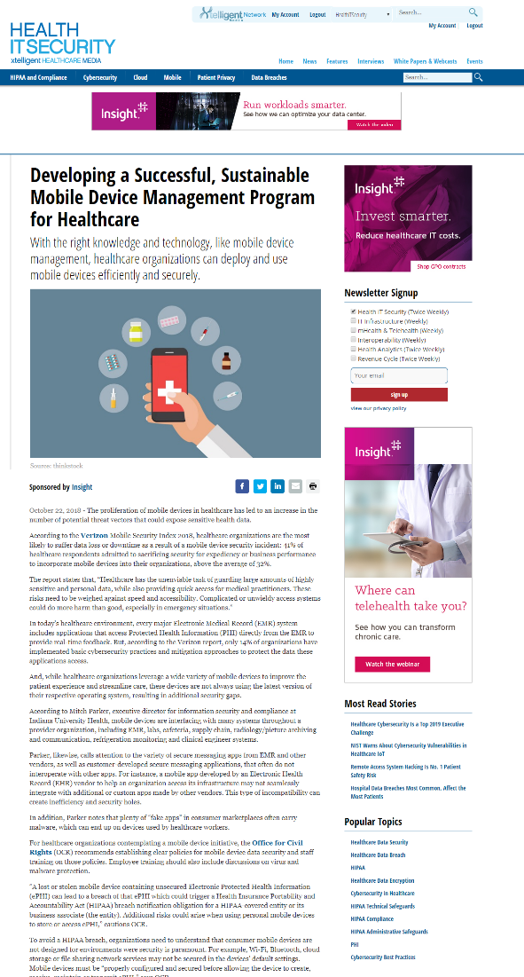
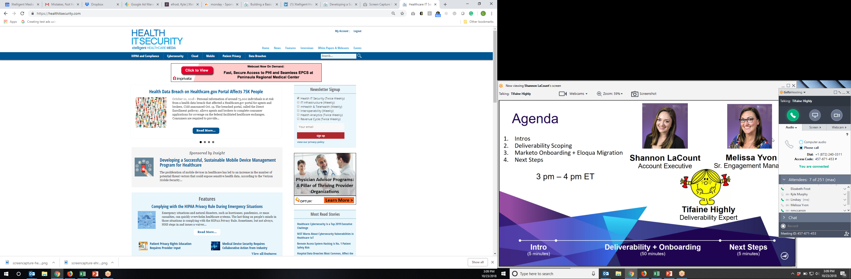
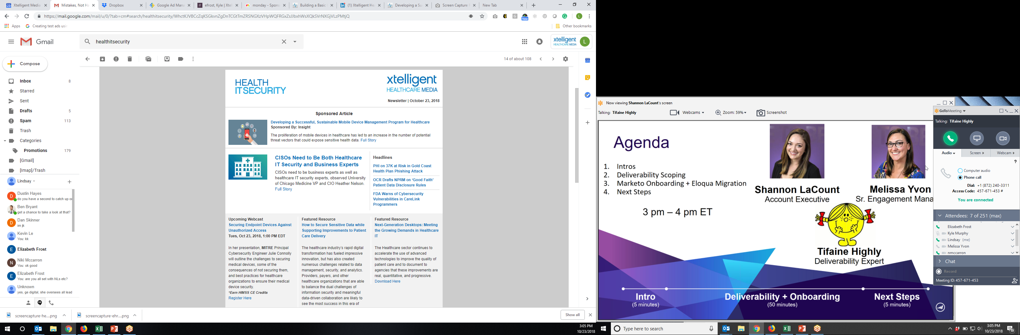
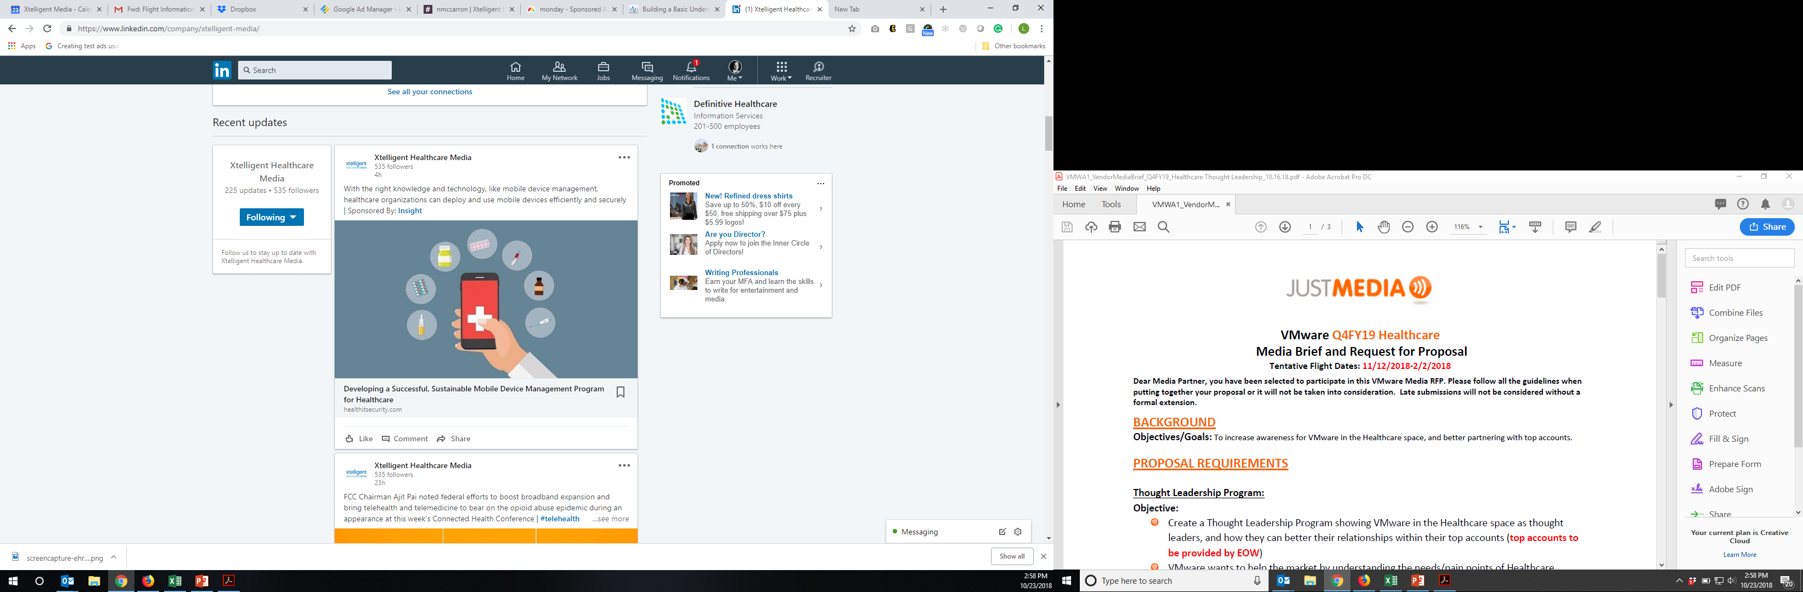
Sponsored Article Series
Share your thought leadership by contributing an article series to be featured on multiple sites.
Series of three articles will appear on the website of your choice:
Can be written by a thought leader from your company or by our editorial staff
Full branding on the article pages
Article Promotion Includes:
Listed on home page of related site
Feature in related newsletter as sponsored content reaching 10,000-58,000 subscribers
Promotions to site’s Twitter account, as well as
the Xtelligent Media LinkedIn Feed
All articles are enabled to be shared by readers

Slide 30
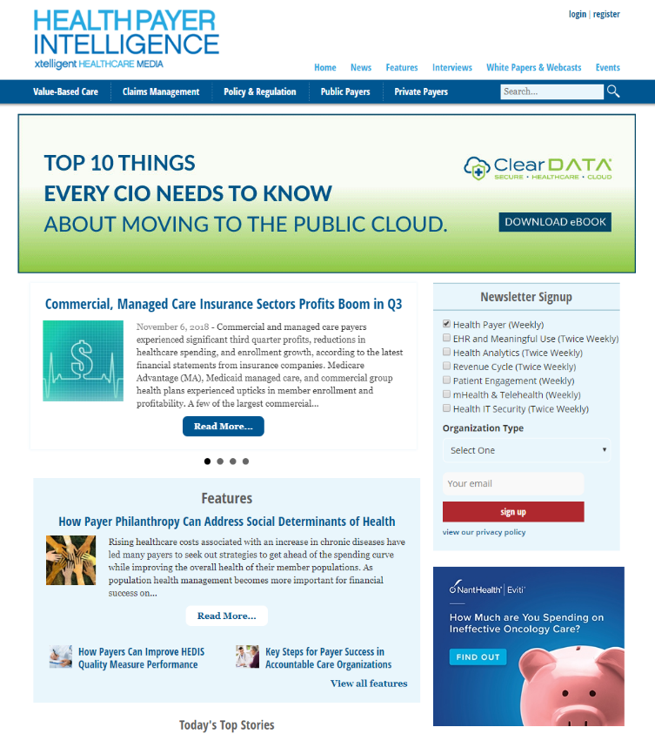
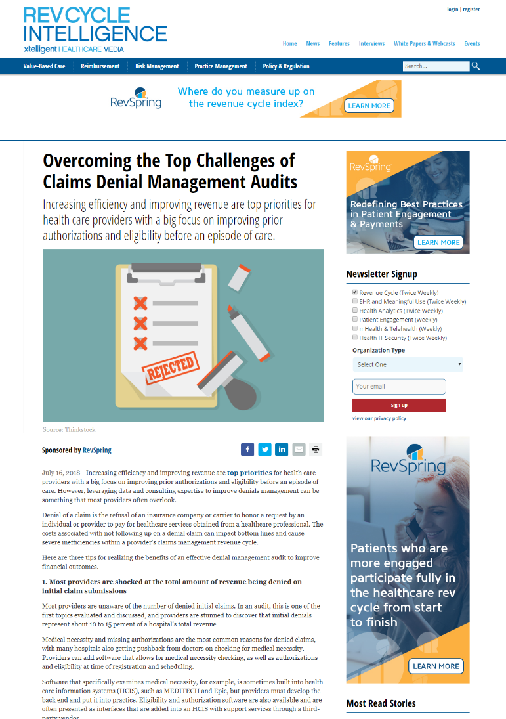
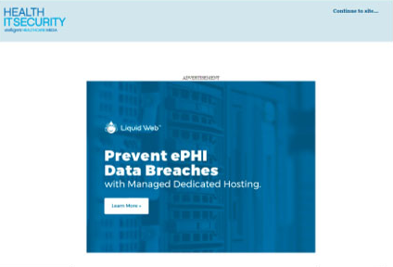
Display Advertising
Welcome Ad w/ 300x600 Companion Ad
640x480 Ad unit that appears as site is loading
Fades after 10 seconds or user can opt to continue to the site
300x600 companion ad contextually aligns your brand within our articles
Billboard
970x250 top of page delivery; dominant position above the fold
Standard IAB Units
300x250 Messaging Unit
300x600 Half Page Ad
728x90 LeaderBoard
Present your message in context. Align your creative with relevant content. Visual reach and frequency supports all of your marketing efforts.

Slide 31

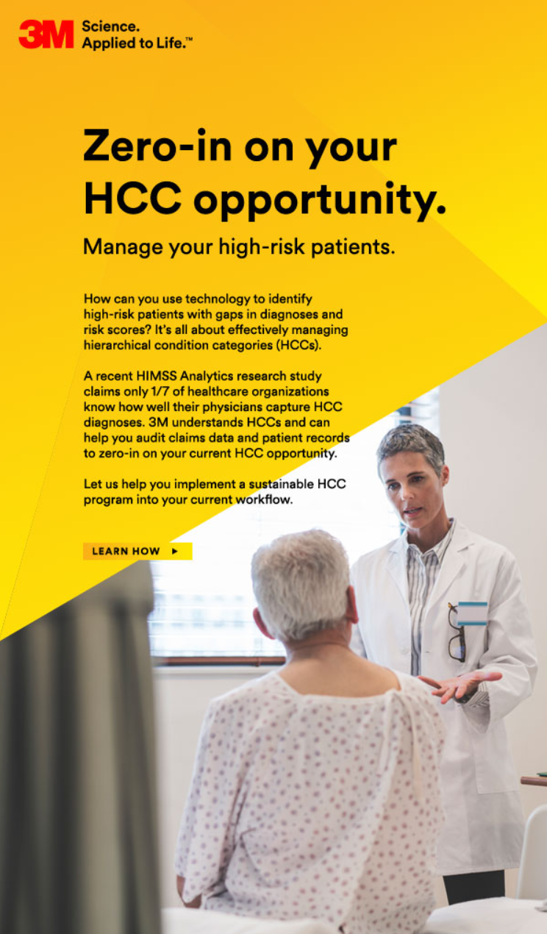
Email Blasts (eBlasts)
Promote products and services to specific audience segments that meet your criteria. Drive traffic to landing pages on your website.
Gain direct access to our opt-in email list
100% Share of Voice
100% Customizable
Delivered only to engaged users of our sites
Data-driven audience segmentation based on campaign goals
Limited Inventory for each audience/site segment to maximize engagement

Slide 32
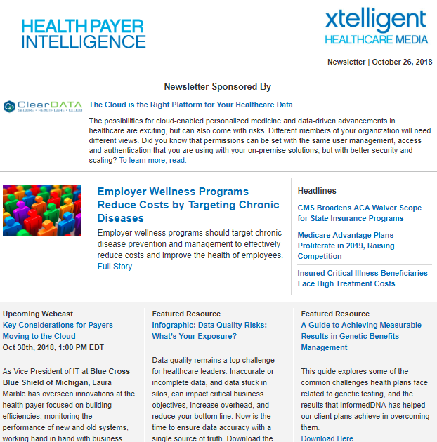
Newsletters
Each site offers email newsletters that help subscribers keep up to date on the topics they care most about.
Our newsletters feature news recaps, in-depth articles and interviews with industry luminaries and experts.
Advertisements are featured at the top of the newsletter for greater visibility
Exclusive placement on all deployments for the week
Includes logo, call to action (CTA) and 50 words of text

Slide 33
Xtelligent Healthcare Media Events

Slide 34

June 6-7, 2019 in Atlanta
Past Attendee Profile
Position your company as an innovator in the fastest-growing segment of healthcare. Present your solutions to providers representing leading hospitals and physician practices.
Sponsorship opportunities include:
Speaking/Panel opportunities
Networking with key decision-makers
Hosted VIP dinners
Sharing thought leadership within the value-based marketplace
Branding on all promotional materials
11%
11%
37%
12%
12%
37%
14%
14%
15%
25%
18%
25%
18%
5%
5%
5%
35%
5%
6%
6%
6%
39%
11%
10%
36%
33%

Slide 35

October 24-25, 2019 in Boston
Present your solutions within the landscape of value-based care. Share best practices and actionable information with attendees from leading hospitals and physician practices, payers, pharma and more.
Past Attendee Profile
Present your solutions within the landscape of value-based care. Share best practices and actionable information with attendees from leading hospitals and physician practices, payers, pharma and more.
Sponsorship opportunities include:
Speaking/Panel opportunities
Networking with key decision-makers
Hosted VIP dinners
Sharing thought leadership within the value-based marketplace
Branding on all promotional materials
12%
12%
14%
14%
15%
17%
6%
9%
16%

Slide 36
Xtelligent Healthcare Media Properties

Slide 37

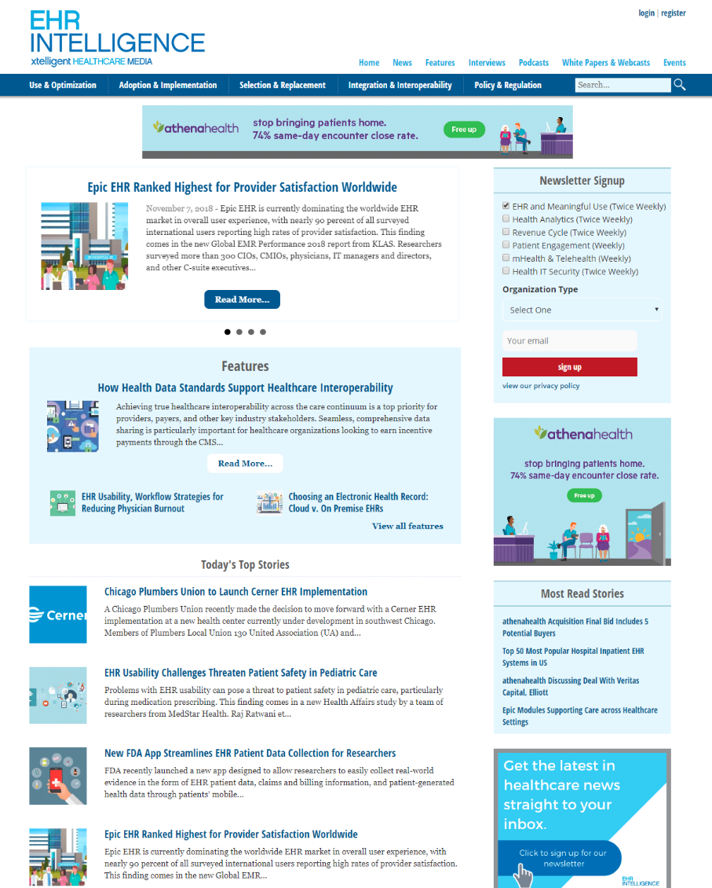
The leading resource for news and topics relevant to EHR, practice management, purchasing, implementation and maintenance processes.
Covered Topics Audience Includes
EHR Implementations
Healthcare Interoperability
MACRA, MIPS, QPP
EHR Vendors
EHR Replacement
EHR Optimization
Medical/Quality/Care Managers
Hospital Administrators (CFOs, CEOs, CMOs)
IT Staff
Health Information Managers
Nursing/Nursing Executives
Senior IT Managers (CIO, CTO, VP, Director)
160,000+ monthly page views
93,000 unique visitors/month
69,000 newsletter subscribers
*stats as of Aug 2019

Slide 38

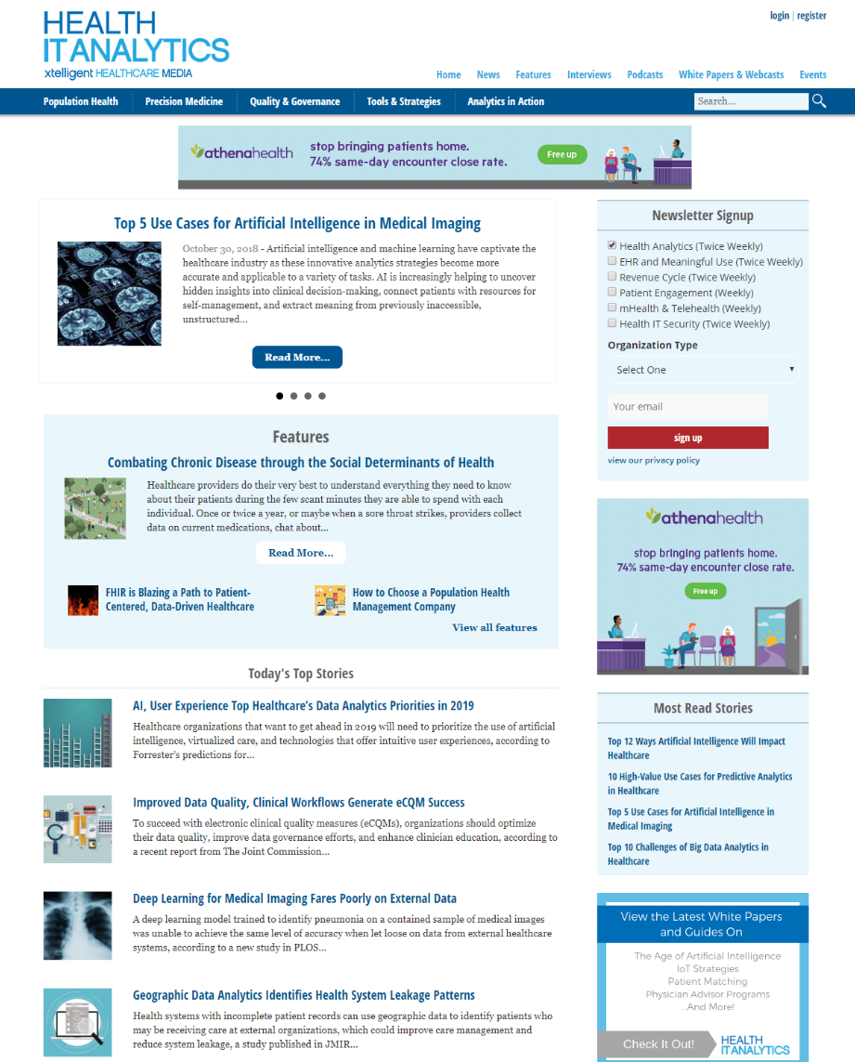
The leading resource for all topics related to the use of analytics in healthcare to improve quality of care and the bottom line.
Covered Topics Audience Includes
Artificial Intelligence
Big Data Analytics
Predictive Analytics
Natural Language Processing
Clinical Decision Support
Population Health
Health Information Management
Data Scientists, Analysts, Informaticists
CIOs, CEOs & CMIOs
Nursing Staff, CNOs
Care Coordinators and Managers
Quality Managers and Clinical Quality Managers
125,000+ monthly page views
63,000 unique visitors/month
49,000 newsletter subscribers
*stats as of Aug 2019

Slide 39

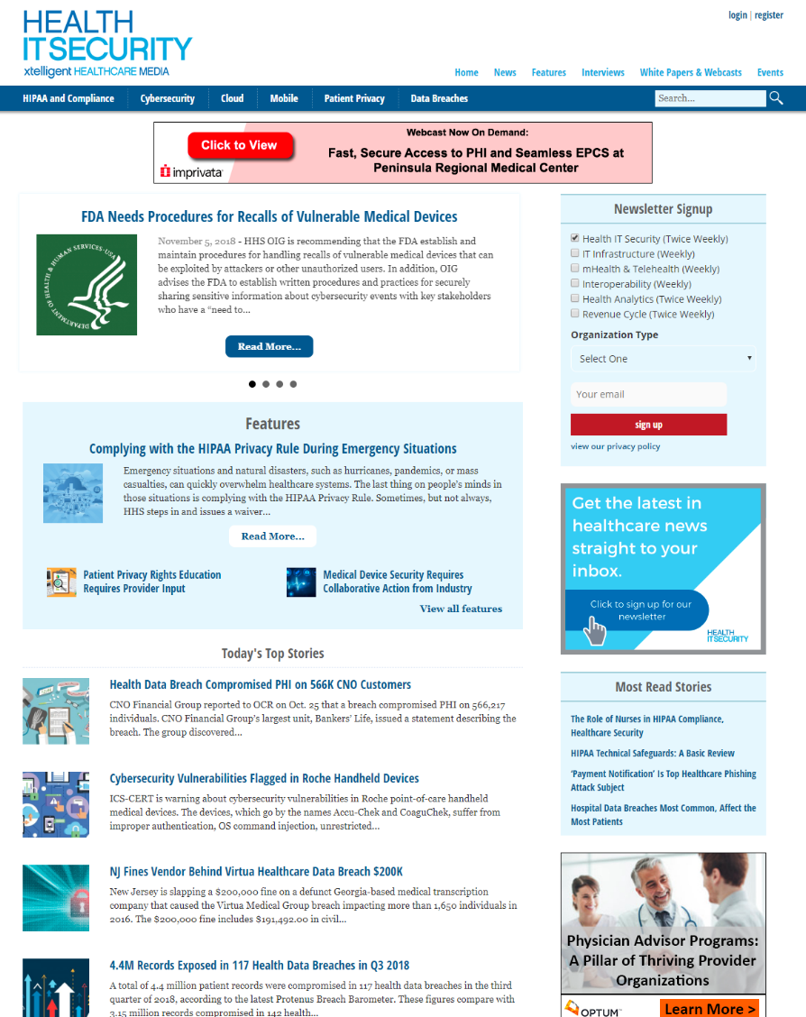
The leading resource for news and topics relevant to healthcare security.
Covered Topics
Audience Includes
Business Associates, BAAs
HIPAA Violations
HIPAA Technical Safeguards
Cybersecurity
Health Data Breaches
HIPAA Compliance
CIOs
Health Information Managers
CTOs
Chief IT Directors
Compliance Officers
Hospital Administrators
185,000+ monthly page views
45,000 unique visitors/month
44,000 newsletter subscribers
*stats as of Aug 2019

Slide 40

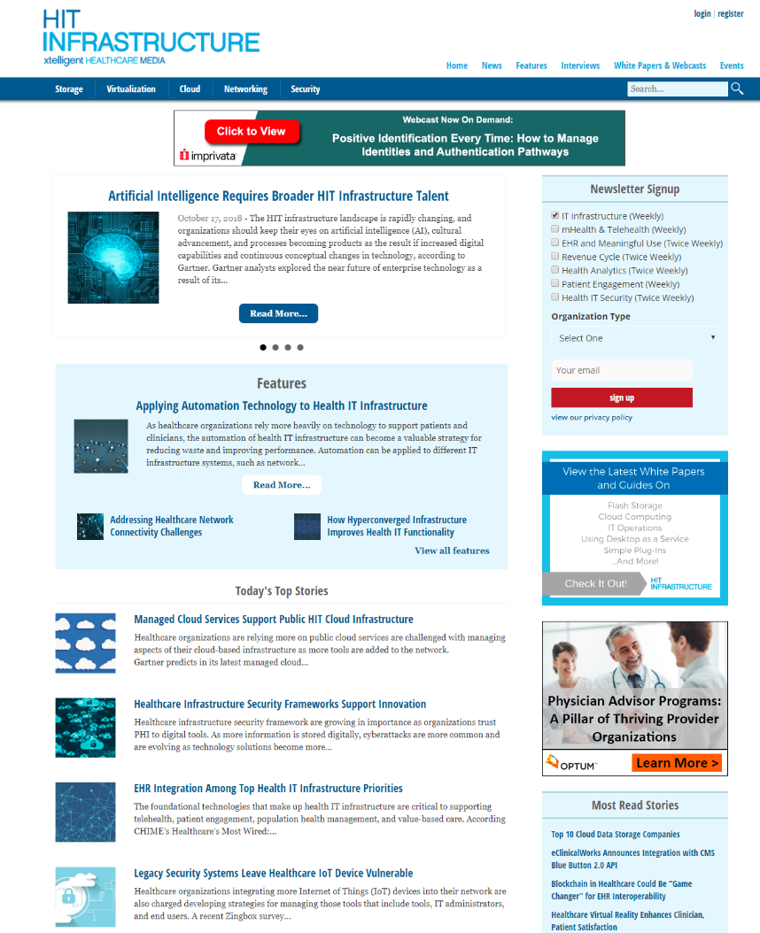
The leading resource for the latest news and exclusive interviews with subject matter experts about IT infrastructure in the healthcare industry.
Covered Topics
Audience Includes
Healthcare Cloud Companies
Healthcare Data Storage
Healthcare APIs
Backup and Disaster Recovery
Healthcare Data Warehouse
Healthcare Interoperability
Chief Executives/ Administrators
Senior IT Managers (CIO/CTO/VP/Director)
CMIOs
IT Staff
Network/Systems Administrators
30,000+ monthly page views
15,000+ unique visitors/month
13,000 newsletter subscribers
*stats as of Aug 2019

Slide 41

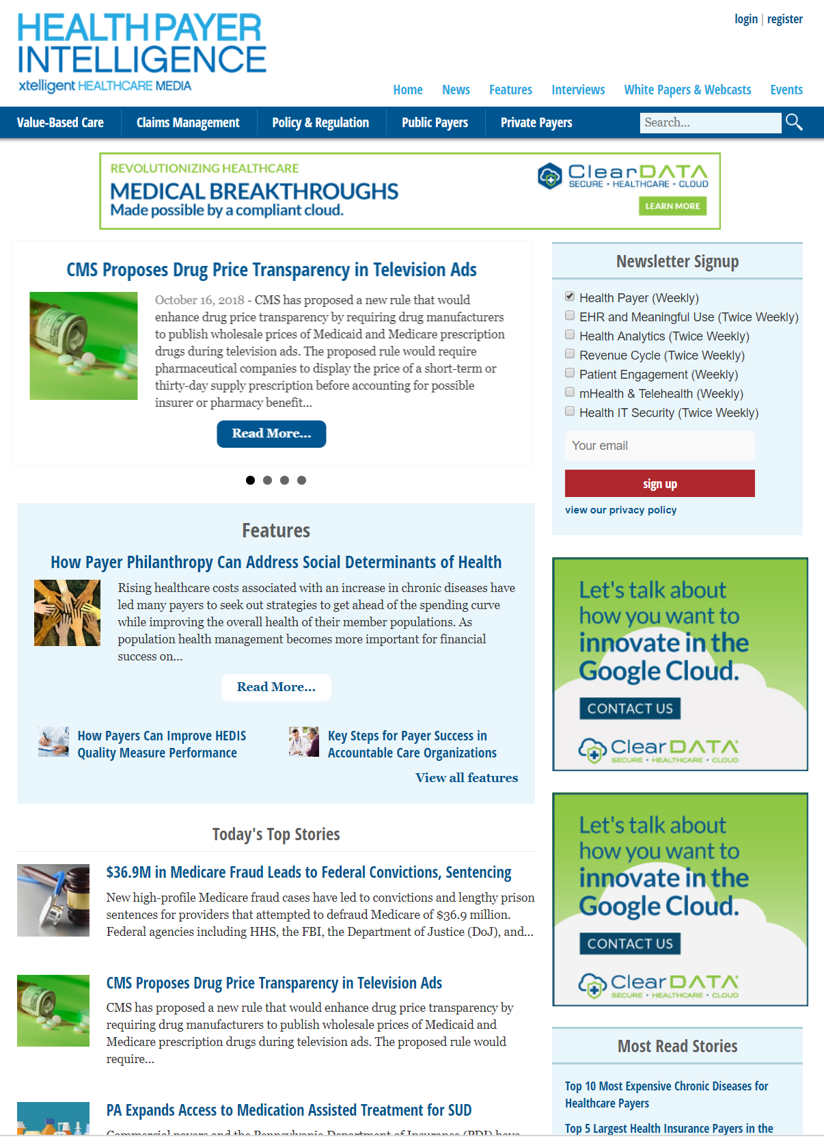
The leading resource for the latest news and exclusive interviews with subject matter experts related to the health payer industry.
Covered Topics
Audience Includes
Chronic Disease
Affordable Care Act
Consumer-Directed Health Plans
Accountable Care Organizations
HEDIS Measures
CMS Star Ratings
CEOs
CFOs
CMOs, CMIOs, COOs
Medical Directors
Pharmacy Directors
Compliance Officers
127,000+ monthly page views
72,000 unique visitors/month
33,000 newsletter subscribers
*stats as of Aug 2019

Slide 42


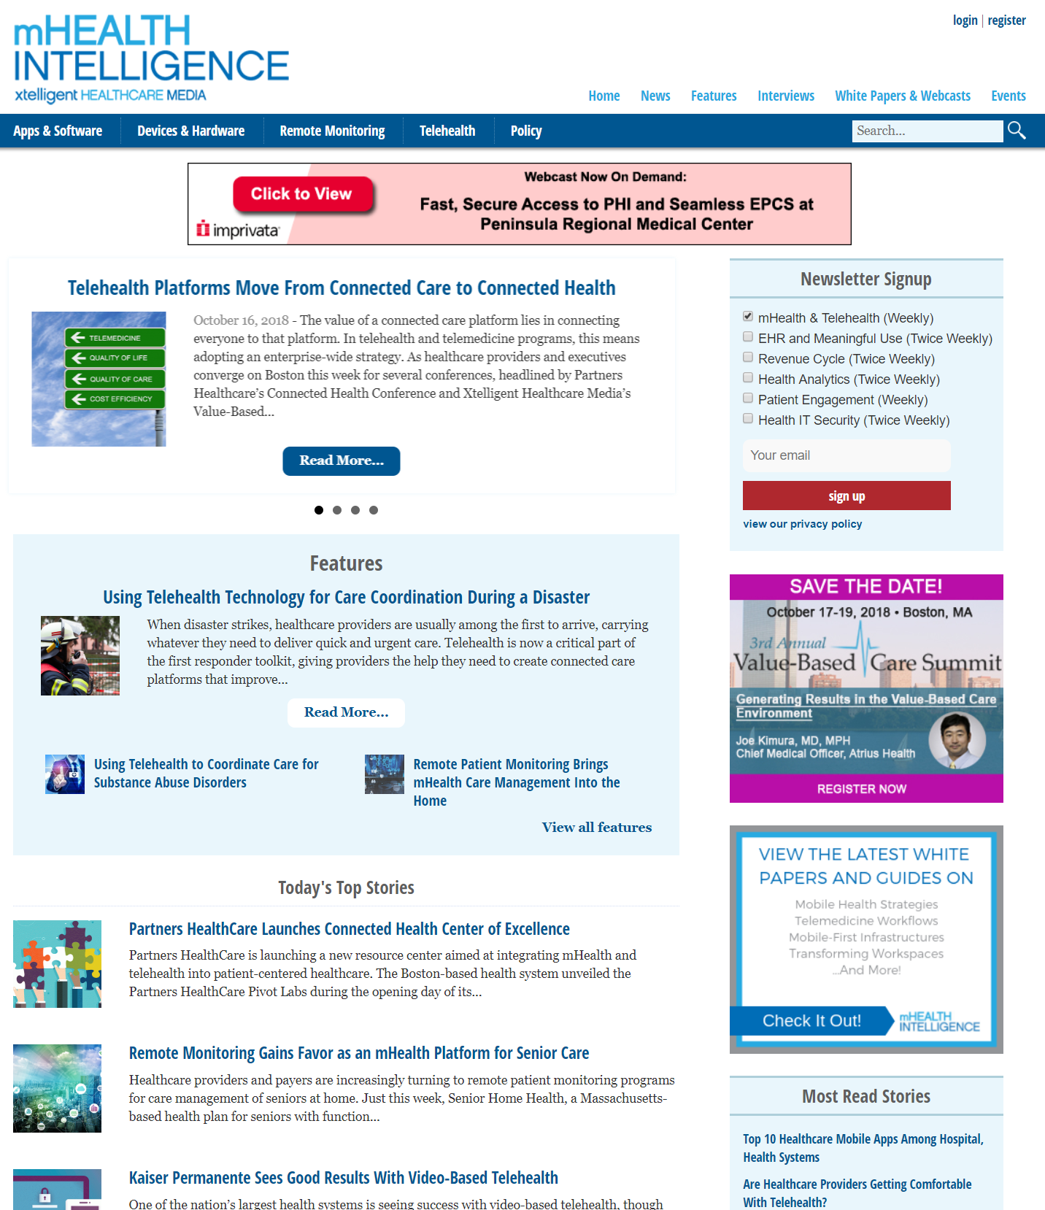
The leading resource for emerging trends in mobile health (mHealth) and telehealth for healthcare organizations and providers.
Covered Topics Audience Includes
Healthcare Mobile Apps
Remote Patient Monitoring
mHealth App Design, Development
Telehealth Reimbursement
Telehealth Reimbursements
Telehealth Models
CEOs, CMIOs, Administrators
Nursing Executives
Clinical/Care Managers
Health Information Managers
Senior Non-IT Managers
103,000+ monthly page views
45,000 unique visitors/month
38,000 newsletter subscribers
*stats as of Aug 2019

Slide 43


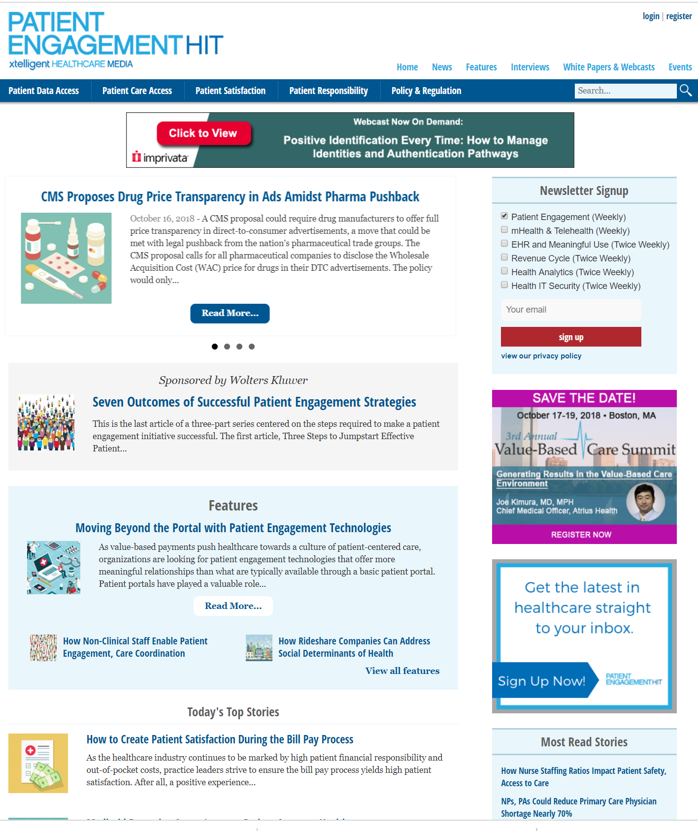
The leading resource for the latest news and analysis on issues surrounding patient engagement.
Covered Topics
Audience Includes
Nurse Communication
Patient Portals
Patient Safety
Patient Access
Patient Activation
Patient Experience
Nurse/Nursing Executives
Chief Executives/ Administrators
Clinical/Quality/Care Managers
Senior Non-IT Managers
Physicians
92,000+ monthly page views
49,000 unique visitors/month
30,000 newsletter subscribers
*stats as of Aug 2019

Slide 44


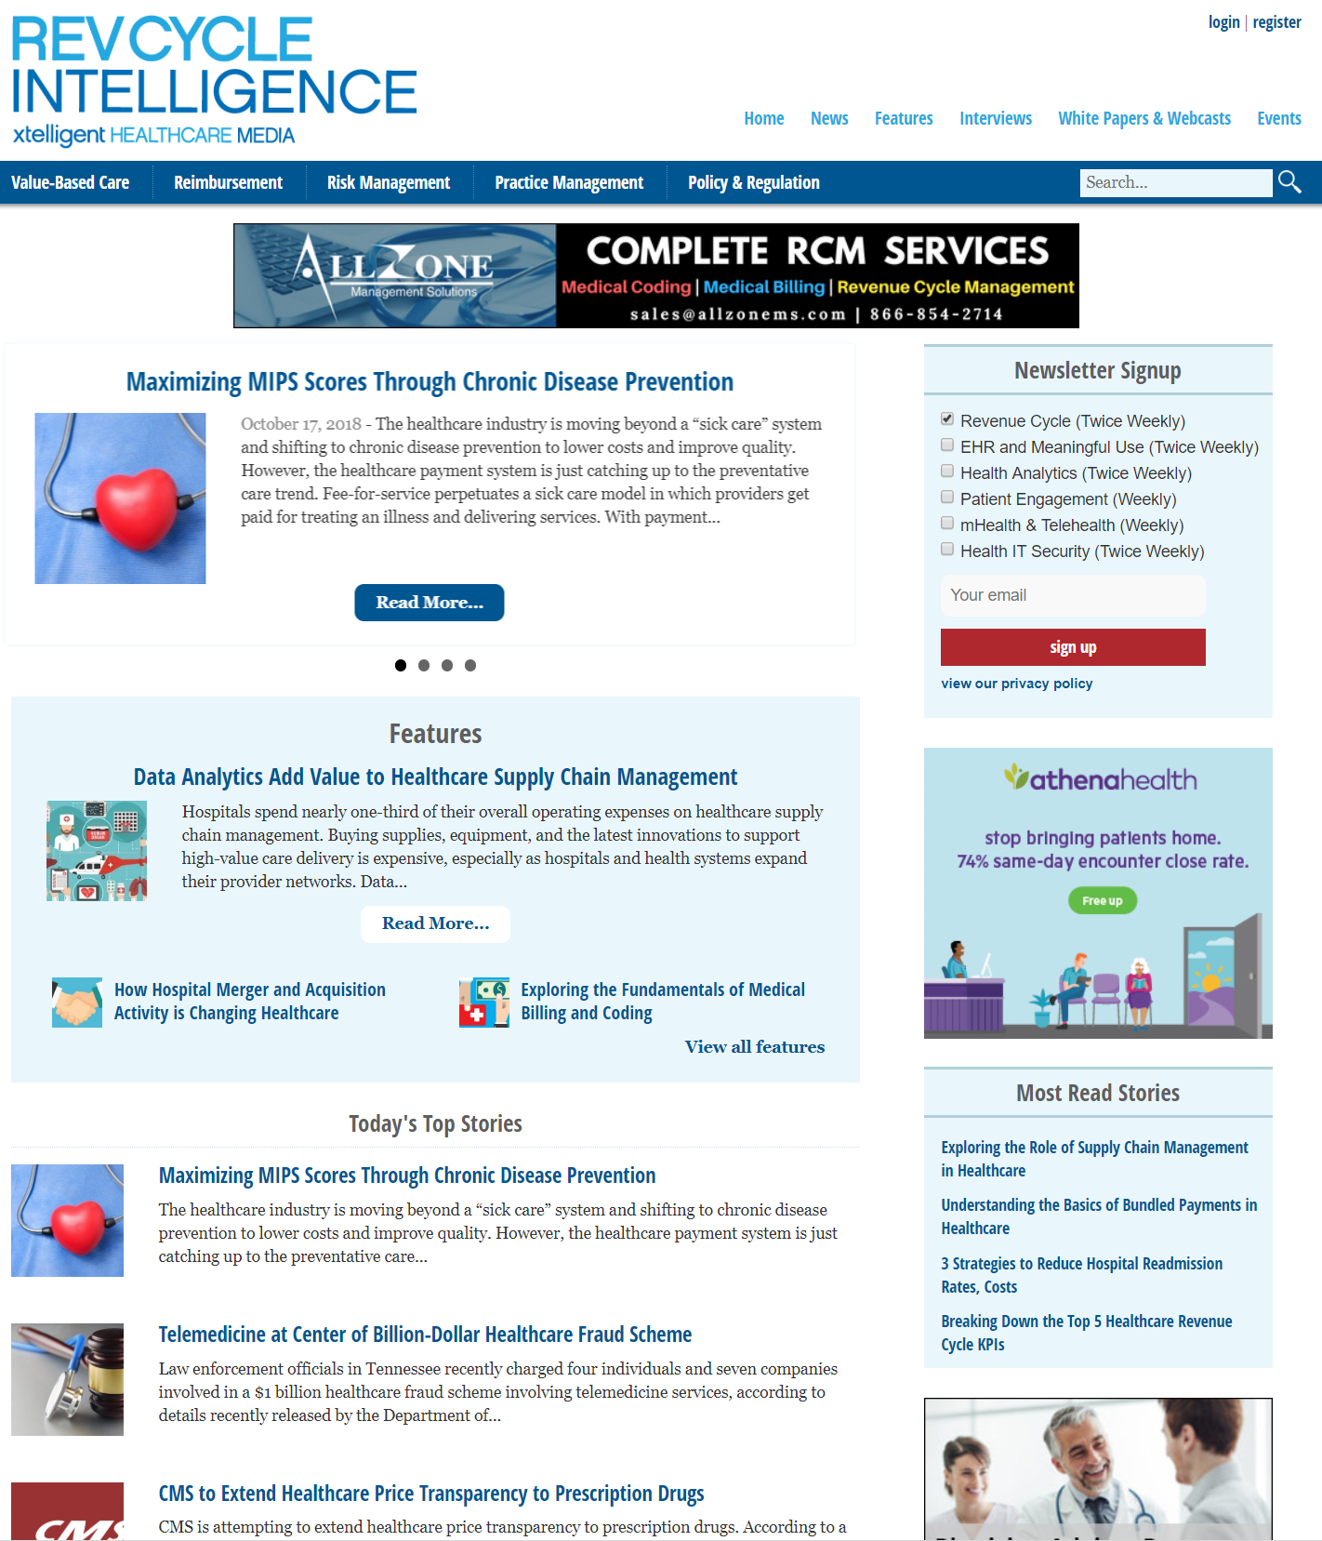
The leading online resource for information about the revenue cycle for both payers and healthcare providers.
Covered Topics Audience Includes
Value-Based Care
Revenue Cycle Management
Supply Chain Management
Bundled Payments
Claims Management
Claims Reimbursement
Chief Financial Officers
Directors of Revenue Cycle
Controllers
Directors of Patient Accounts & Financial Services
Business Managers
136,000+ monthly page views
69,000 unique visitors/month
35,000 newsletter subscribers
*stats as of Aug 2019

Slide 45
Our Websites & Events
Events

Slide 46

Thank you.

